Slide 1
Review of previous classes
Nano in Histroy
The Localized Surface Plasmon Resonance
DICHROISM
Development of nanoscience and technology
Diversity of nano field
Surface to volume atoms of Cuboctahedral system
M(K) = (1/3)*(10K³+15K²+11K+3), K = No. of shell
N_{K} =10K² + 2, Every shell contains number of shell
1. Nanotechnology in upward motion: next future of science and technology is nanotechnology
2. Constructive - Destructive interference by thin films
3. Non-Reflective Surfaces
4. Super-Hydro-Phobicity
5. Self-Cleaning
SIZE EFFECT
Quantum Effect
Colour, Melting point, Specific heat, Electrical, Magnetic properties etc.
To-Down Method of Preparation
Ball mill, Thermal, Arc discharge, Laser ablation etc. Lithography
Bottom – up preparation method
Characterization: AFM, STM, TEM, SEM, IR, Raman, XRD etc.
Carbon Nanotube
Energy at Nanoscale, Nanomechanics, Nanoelectronics, Application etc.

Slide 2
Review of previous classes
Nano in Histroy
The Localized Surface Plasmon Resonance
DICHROISM
Development of nanoscience and technology
Diversity of nano field
Surface to volume atoms of Cuboctahedral system
M(K) = (1/3)*(10K³+15K²+11K+3), K = No. of shell
N_{K} =10K² + 2, Every shell contains number of shell
1. Nanotechnology in upward motion: next future of science and technology is nanotechnology
2. Constructive - Destructive interference by thin films
3. Non-Reflective Surfaces
4. Super-Hydro-Phobicity
5. Self-Cleaning
SIZE EFFECT
Quantum Effect
Colour, Melting point, Specific heat, Electrical, Magnetic properties etc.
To-Down Method of Preparation
Ball mill, Thermal, Arc discharge, Laser ablation etc. Lithography
Bottom – up preparation method
Characterisation: AFM, STM, TEM, SEM, IR, Raman, BET, DLS etc.
Carbon Nanotube
Curvature
Properties

Slide 3
SURFACE CURVATURE
Surface curvature has important role to define the properties of materials
CLASS OF MATERIALS
Metallic materials
Ceramic materials: (ionic in nature or co-valent or mixture)
They have very good corrosion resistance properties
(c) Polymer materials
Natural: Proteins enzymes etc.
Good insulators and have good corrosion resistance
(d) Composite materials
One act as matrix and other act as reinforcement phase
(e) Electronic materials (it is very broad (metal, semiconductor and insulator)
(f) Magnetic materials
(g) Biomaterials
(h) Nanomaterials (0-d, 1-d, 2-d and 3-D)

Slide 4
INTERNAL STRUCTURE
ATOMIC STRUCTURE
ATOMIC BONDING
IONIC, CO-VALENT, VANDERWALL, METALLIC
Net force is zero F_{N}=F_{r}+F_{a}=0
CRYSTAL STRUCTURE
ALLOTROPIC TRANSFORMATINS
Fe: BCC at room temperature
FCC at 750⁰C
FCC at 125Kbar at room temperature
MOLECULAR STRUCTURE
Polymer

Slide 5
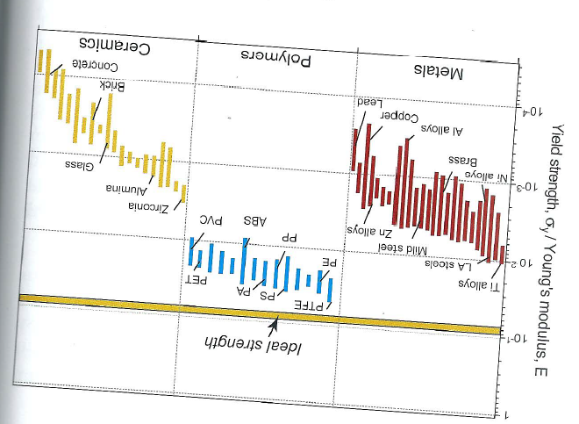
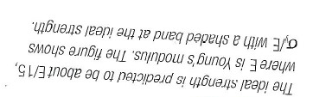
DEFECTS
Point Defects (Scottkey defects, Frenkel defects)
Linear Defects (Edge dislocations)
Planer Defects (Interfacial defects, Grain boundary, Interphase boundary)
Volume defects
Casting defects (Cavities and gas holes)
MECHANICAL BEHAVIOUR

Slide 6
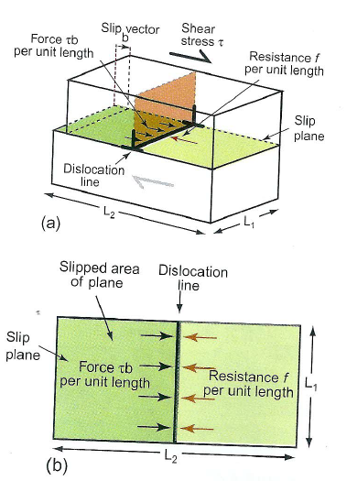
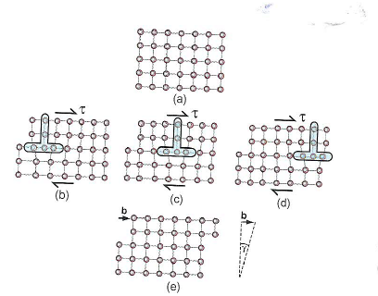
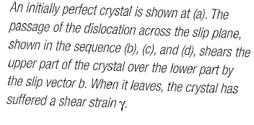
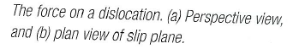

Slide 7
Size Effect
• Delocalization of the valency electron (Discrete energy level)
• Structure also changes with size.
• The above two changes can lead to different physical and chemical
properties, depending on size
Optical properties
Bandgap
Melting point
Specific heat
Surface reactivity
Magnetic property
Electrical conduction,
Sterical,
Biological So on…..

Slide 8
Specific heat
• C = ∆Q/m∆T; the amount of heat ∆Q required to raise the temperature by ∆T of a sample of mass m
• Specific heat of polycrystalline materials given by Dulong-Petit law (1819) - > Specific heat of a crystal is due to lattice vibration -> 3RM ⁻¹(R is gas constant and M is the molar mass)
It fails at low temperature, Debye model - > Particle in a box principle to Phonons (i.e. Phonon in a box)
c_{s} velocity of sound
• C_{v} of nanocrystalline materials are higher than their bulk counterparts. Example:
- Pd: 48% ↑ from 25 to 37 J/mol.K at 250 K for 6 nm crystalline
- Cu: 8.3% ↑ from 24 to 26 J/mol.K at 250 K for 8 nm
- Ru: 22% ↑ from 23 to 28 J/mol.K at 250 K for 6 nm

Slide 9
Melting point of nanocrystalline mterials
∆θ = Deviation of melting point from the bulk value
T_{o} = Bulk melting point
σ = Surface tension coefficient for a liquid-solid interface
ρ = Particle density
r = Particle radius
L = Latent heat of fusion

Slide 10
• Lowering of the melting point is proportional to 1/r
• Δθ can be as large as couple of hundred degrees when the particle size gets below 10 nm!
Note: For nanoparticles embedded in a matrix, melting point may be lower or higher, depending on the strength of the interaction between the particle and matrix.

Slide 11
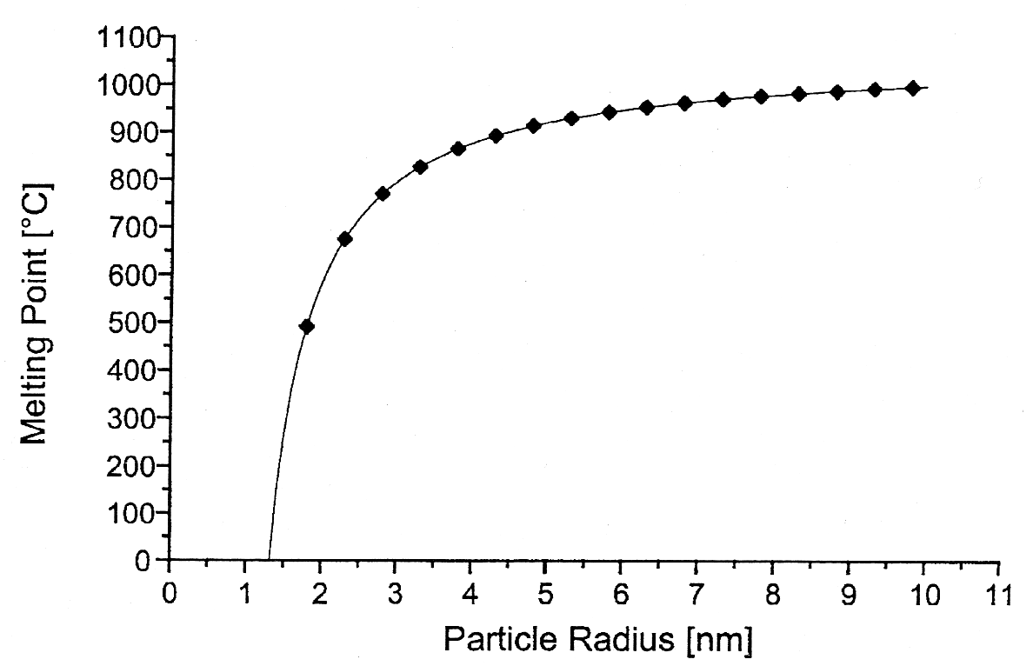
The melting point of gold particles decreases dramatically as the particle size gets below 5 nm
Source: Nanoscale Materials in Chemistry, Wiley, 2001

Slide 12
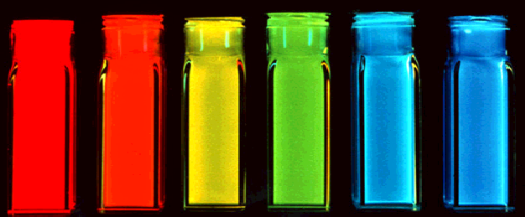
Optical properties of Nanomaterials
Ordinary light excites all color quantum dots.
(Any light source “bluer” than the dot of interest works.)
Quantum dots change color with size because additional
energy is required to “confine” the semiconductor
excitation to a smaller volume.

Slide 13
Electrical Conductivity
• For metals, conductivity is based on their band structure.
µ_{e} =mobility, m_{e} = effective mass of electron, ν_{F} =Fermi velocity of the electron, λ =meen free path
Scattering mechanisms
(1) By lattice defects (foreign atoms, vacancies, interstitial positions, grain boundaries, dislocations, stacking disorders)
more or less independent of temperature
(2) Scattering at thermal vibration of the lattice (phonons)
independent of lattice defects, but dependent on temperature
Electric current collective motion of electrons; in a bulk metal,
Ohm’s law: V = RI, If a bias voltage is applied to the quantum dot (V=e/C), a tunneling current I_{t} is produced:
Band structure begins to change when metal particles become small. Discrete energy levels begin to dominate, and Ohm’s law is no longer valid.
Increase in ceramic and magnetic nanomaterials but Decrease in metals

Slide 14
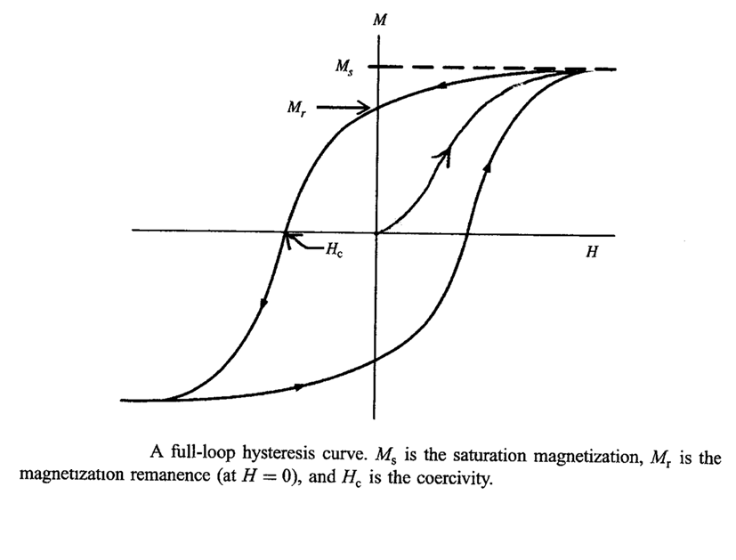
HYSTERESIS
HARD MAGNETS - H_{c} > 100 Oe (MOTORS, GENERATORS),
SOFT MAGENTS - H_{c} < 10 Oe (TRANSFORMER CORES, ELECTRONIC CIRCUITS)

Slide 15
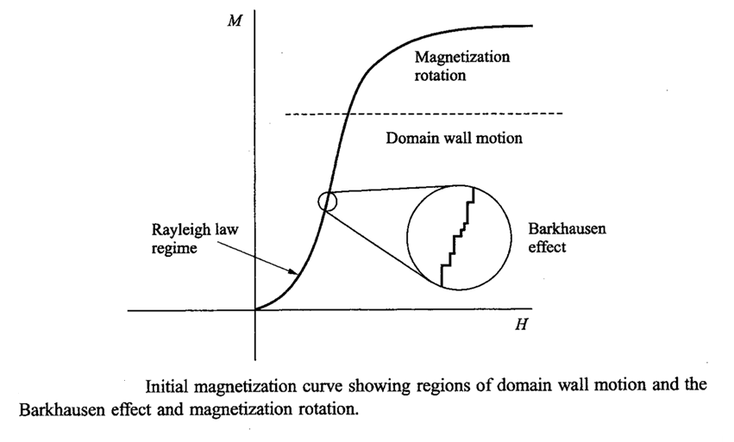
The initial magnetization curve may be divided into two regimes:
(i) Rayleigh law regime and (ii) Magnetization rotation
The low-field behavior of the initial magnetization is given by the Rayleigh law,
µ = µ_{o} + nH (B = µH)
where µ_{o} and n are the Rayleigh constants of the material:
30 < µ_{o} < 10⁵ , 0.5 < n < 1.2 x 10⁷ and B = µ_{o}H + nH²
Hence the parabolic nature of M vs. H at low H.

Slide 16
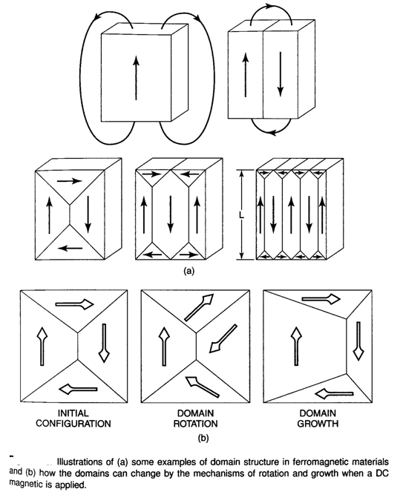
MAGNETIC DOMAINS
An ordinary piece of iron below its curie temperature shows spontaneous magnetization called micromagnetics.
A macroscopic magnetic material will break up into magnetic domains to minimize the energy.

Slide 17
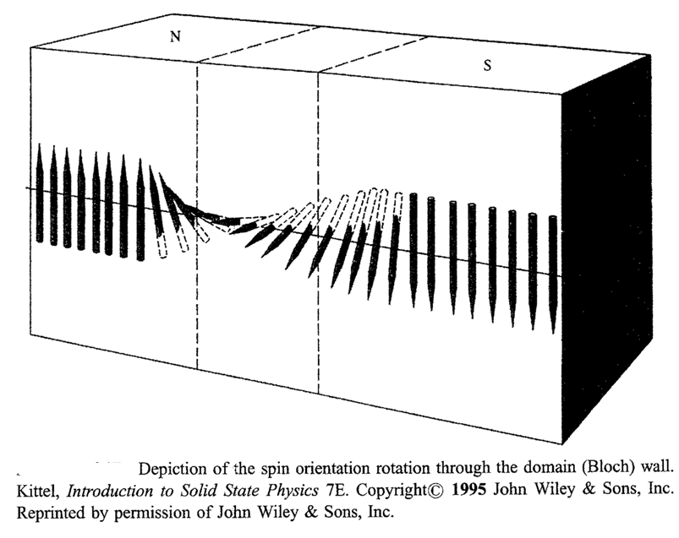

Slide 18
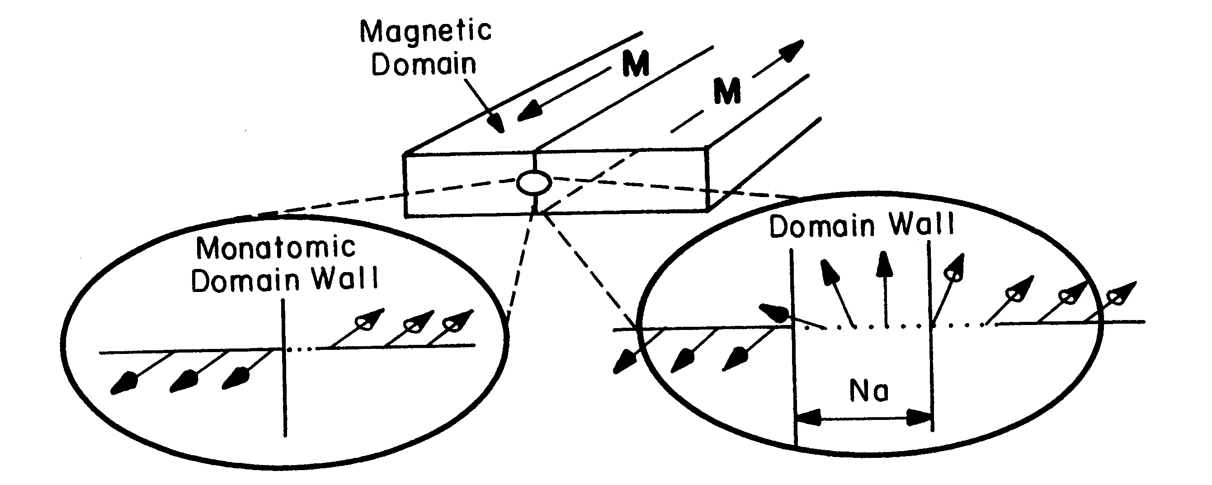
Schematic of ferromagnetic material containing a 180º domain wall (center). Left, hypothetical wall structure if spins reverse direction over one atomic distance. Right for over N atomic distance, a. In real materials, N: 40 to 10⁴.

Slide 19
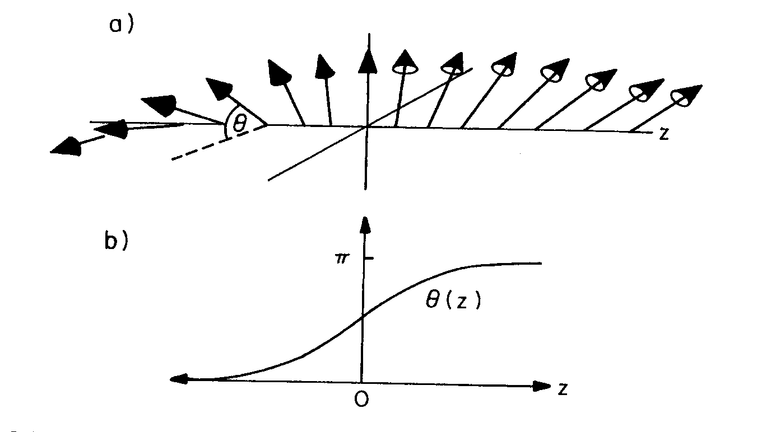
magnified sketch of the spin orientation within
a 180º Bloch wall in a uniaxial materials; (b) an appro-
ximation of the variation of θ with distance z through
the wall.

Slide 20
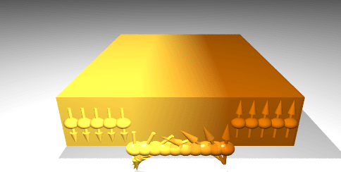
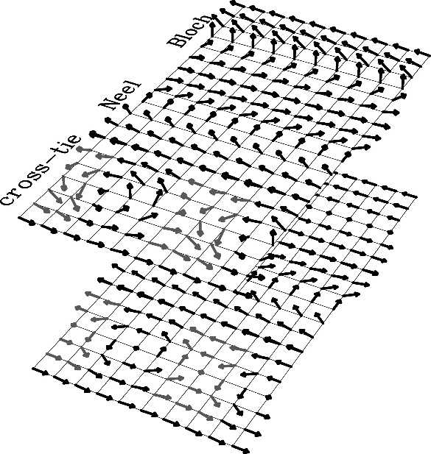
Magnetic Domain and Domain Walls
1. Domain walls
Bloch wall, Néel wall, Cross-Tie wall
The boundary between two magnetic domains in a thin film in which the magnetization vector remains parallel to the faces of the film in passing through the wall.
Cross-tie domain wall is a complex two dimensional magnetic domain wall structure, often found experimentally in thin soft ferromagnetic films with thicknesses of about several exchange lengths. The structure of such a wall can roughly be imagined as a sequence of magnetic vortices and anti-vortices, arranged along a straight line. 2. Magnetic domains
Uniaxial wall spacing , Closure domain
Stripe domains, Head to Head (Votex), Domain in
antiferromagnetic films
3. Single domain and super-paramagnetism
4. Some methods for the domain observation
SEMPA, MFM, Magneto-optical

Slide 21
The critical size below which particle exists as a single domain is given as
SW model is based on certain assumptions such as, (i) within a single domain all the spins are collinear and rotation of spins takes place coherently and collectively and (ii) interaction between the particles is negligible. In this model, the calculation were made for elongated ellipsoidal particles, because the ellipsoidal shape includes all the particle shape of physical interest, such as rod, sphere and disk.
Total anisotropy energy (alignment energy) of a particle is given as
The first term in the equation is anisotropy energy and second term is additional potential energy supplied by the field to the single domain particle

Slide 22
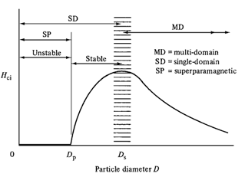
The magnetic coercivity of a magnetic nanoparticle depends significantly on their magneto-crystalline anisotropy, micro-strain, inter-particle interaction, temperature, shape and size.
In the multi domain structure, magnetization reversal occurs through a domain wall motion and the size variation coercivity is given as
At a critical size, particles become single domain where the change of direction of magnetization can occur only by coherent rotation of spins which requires high magnetic field. As an effect, it results in considerably high coercivity. Coercivity is found to be increased with the particle size within a single domain. It is because of the progressively increasing role of thermal fluctuations. Here size dependence of coercivity can be expressed as,

Slide 23
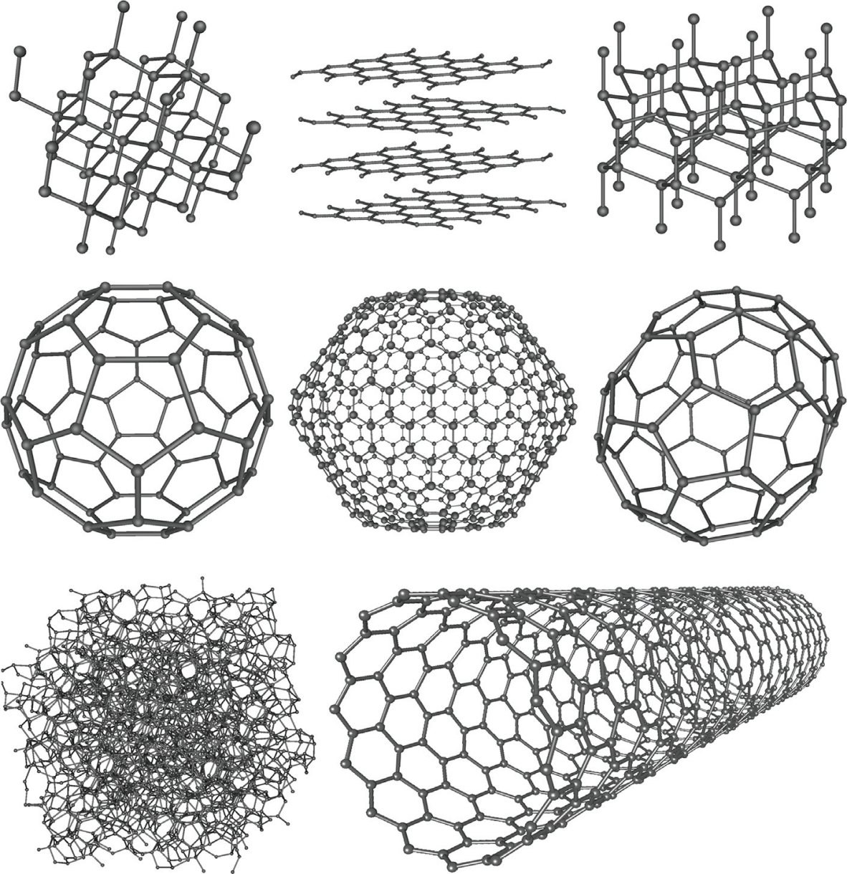
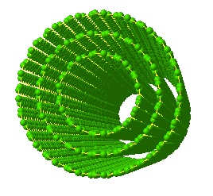
CARBON NANOTUBE
Allomorphs of carbon are depicted. (a) Diamond forms in a tatrahedral (sp3 bonding) arrangement where each carbon is bonded to four others. (b) Graphite is the most stable form of carbon. It forms in planes that consist of hexagonal arrangement of carbon atoms. The bonding in graphite is sp2. Van der Waals forces hold the planes together. (c) Another form of diamond called lonsdaleite has more hexagonal character to its structure. It is believed to form after a meteor impact that transforms graphite into lonsdaleite while creating the hexagonal form of graphite. (d)–(f) Fullerenes were discovered in 1985 by Richard Smalley and his group. Fullerenes are carbon’s representative in the zero-dimensional class of nanomaterials. (g) Amorphous carbon does not have any crystalline structure (no longrange order). Much of amorphous carbon contains small domains of crystalline graphite (also called turbostratic graphite) with some level of amorphous carbon that holds them together.
Coal and soot are amporphous carbons. (h) Carbon nanotubes are called fullerene pipes and comprise (arguably) one of the most remarkable of the carbon allotropic class of materials—or of all materials, for that matter. Glassy carbon is a nongraphitizing carbon that is used in electrodes and for high-temperature crucibles. Glassy carbon is a purely isotropic form of graphite. Carbon nanofoams are considered to be an allomorph of carbon that consists of a three-dimensional structure of carbon clusters. Nanofoams were discovered in 1997 by A. V. Rode et al.
(a)
(c)
(b)
(e)
(f)
(d)
(g)
(h)

Slide 24
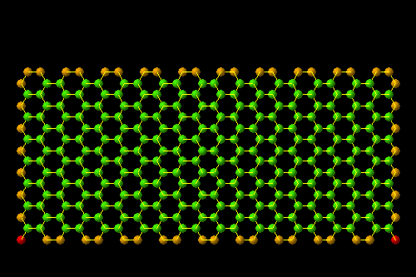
A SINGLE GRAPHITE SHEET: GRAPHENE
An example of mono-dimensional system

Slide 25
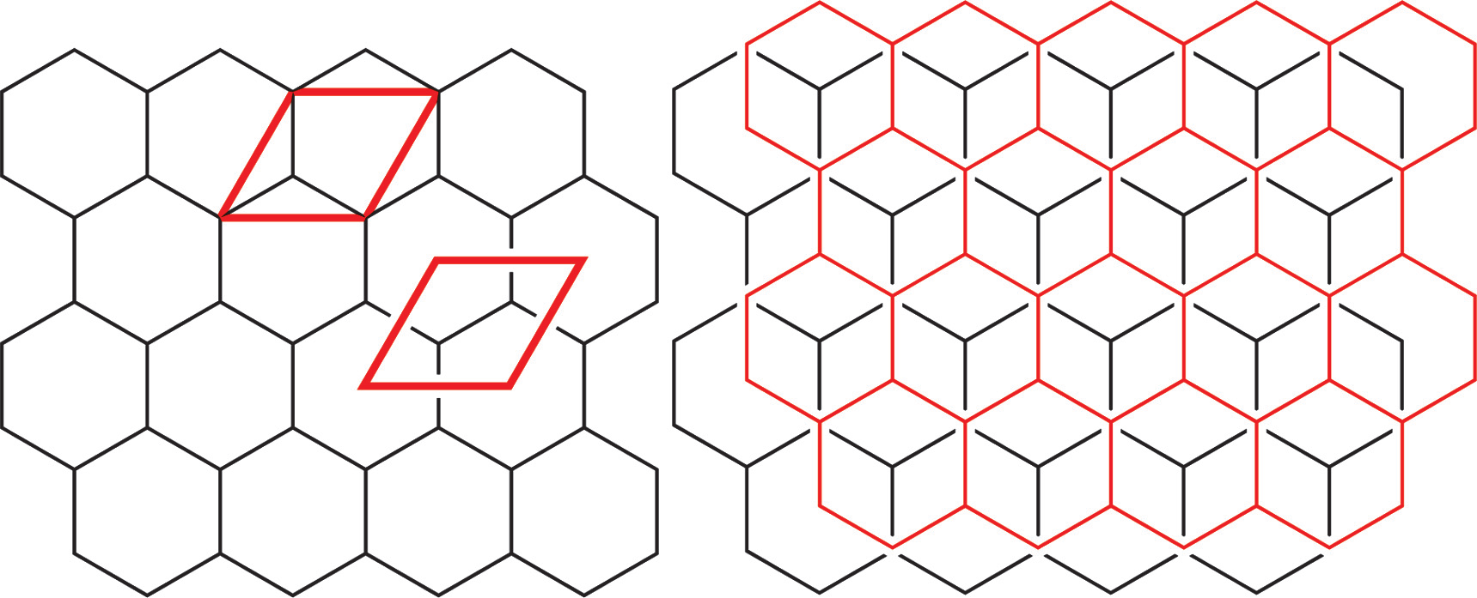
The unit cell of graphite (containing two atoms) is shown on the left. On the right, the relationship between two planes of graphite is depicted.

Slide 26
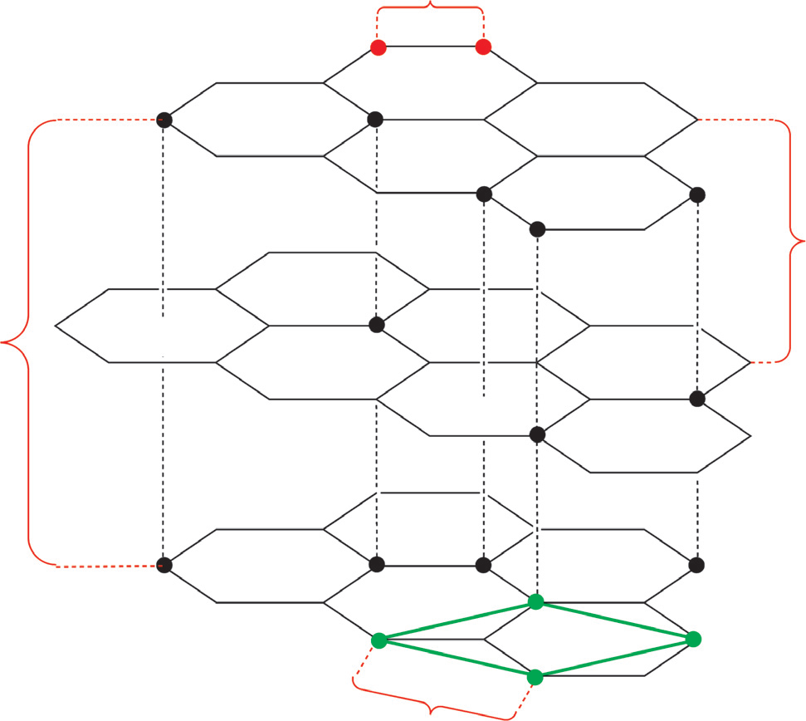
Three layers of graphite are shown. The d-spacing between layers is 3.34 A. The lattice parameter a of the unit cell is equal to 2.46 A. The C–C bond length is 1.42 A.
b_{c–c}= 1.42 Å
d = 3.34 Å
c = 6.708 Å
a = 2.46 Å

Slide 27
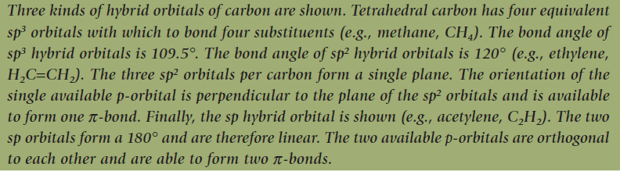
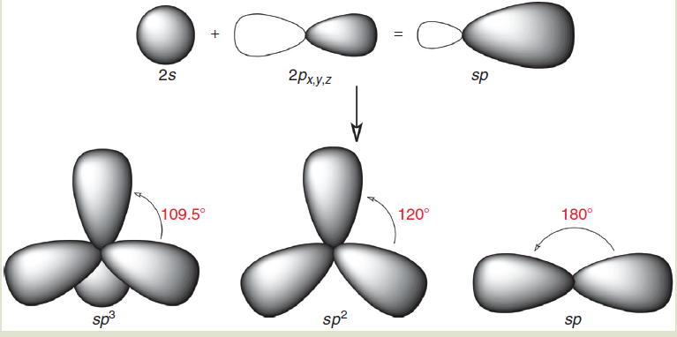

Slide 28
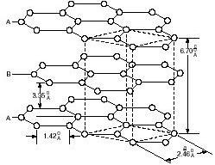
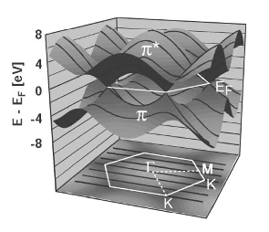
ELECTRONIC STRUCTURE of GRAPHITE
In 3D graphite the inter-planar interactions are weak with respect to the in-plane C-C interactions
The electronic structure of 2D graphite is similar (in first approximation) to that of 3D graphite
The π e π* bands of graphene “touch” in 6 points (at the corners of hexagonal Brillouin zone ) and equal the Fermi energy for one
special wavevector
K- POINT

Slide 29
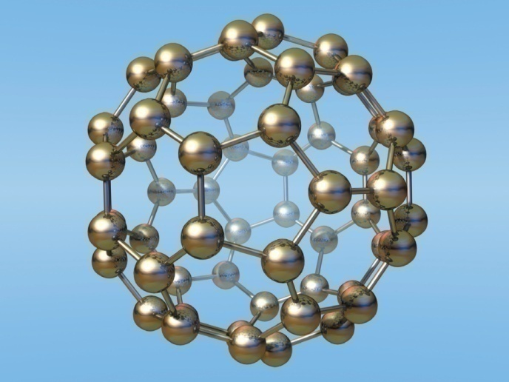
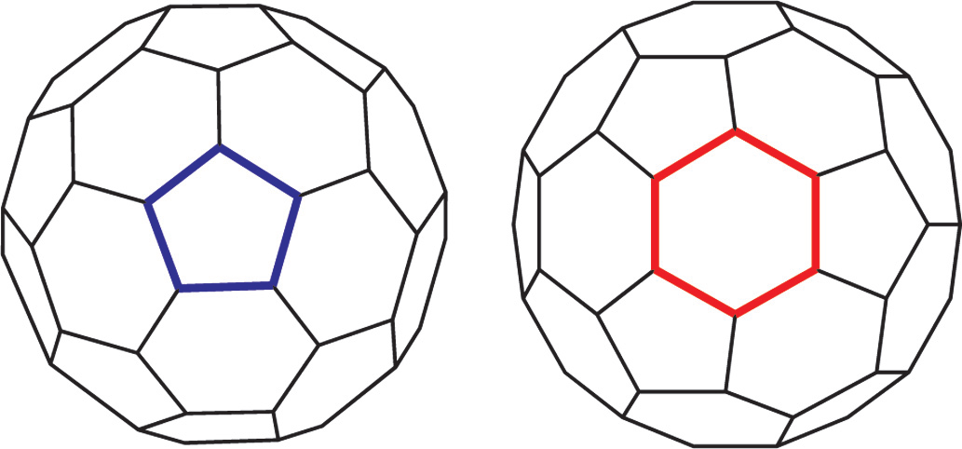
Nc =Odd ( example 3, 11, 15, 19 and 23, sp hybridization, linear or ring structure-> abundance-> tetrahedral bond angles )
Nc = even= cage structures
Nc = 30 -40 - > no stable structure
Nc >40 -> fullerene, C60, C70, C80, C90 etc.
Nc = 60-> 90 edges, 32 faces (12 are pentagons and 20 hexagones) and 60 vertices
Euler’s theorem to polyhedra, f+v=e+2, f = face, v = vertices, e = edges
Diameter = 7.10A, Pentagon has no double bond (bond length = 1.46A. Hexagon has alternate double bonds with bond length 1.40A. (Graphite has only hexagon with bond length 1.42A)

Slide 30
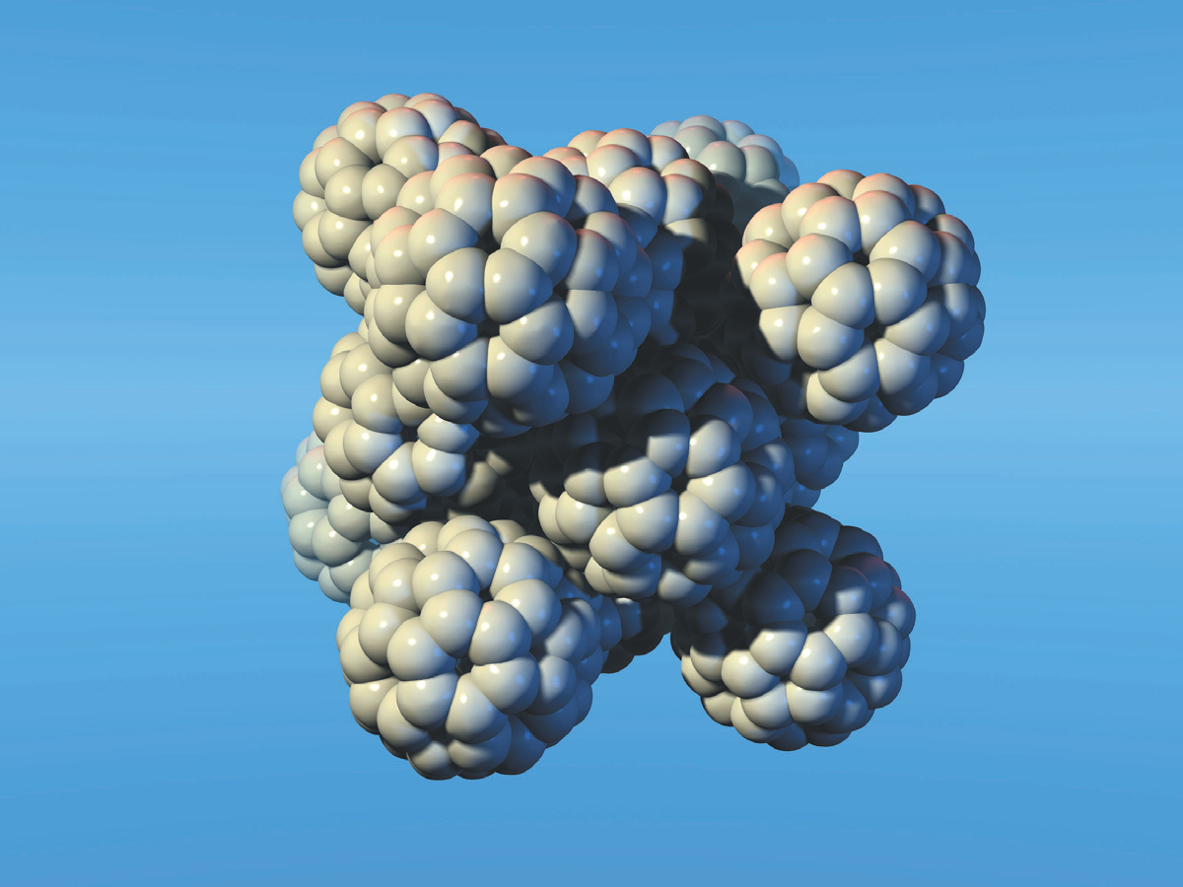
A fulleride crystal is displayed. The crystal shown is an fcc type within which van der Waals gaps separate the constituent fullerenes. Intercalation of metals like lithium between and among fullerenes occurs to form stable complexes.

Slide 31
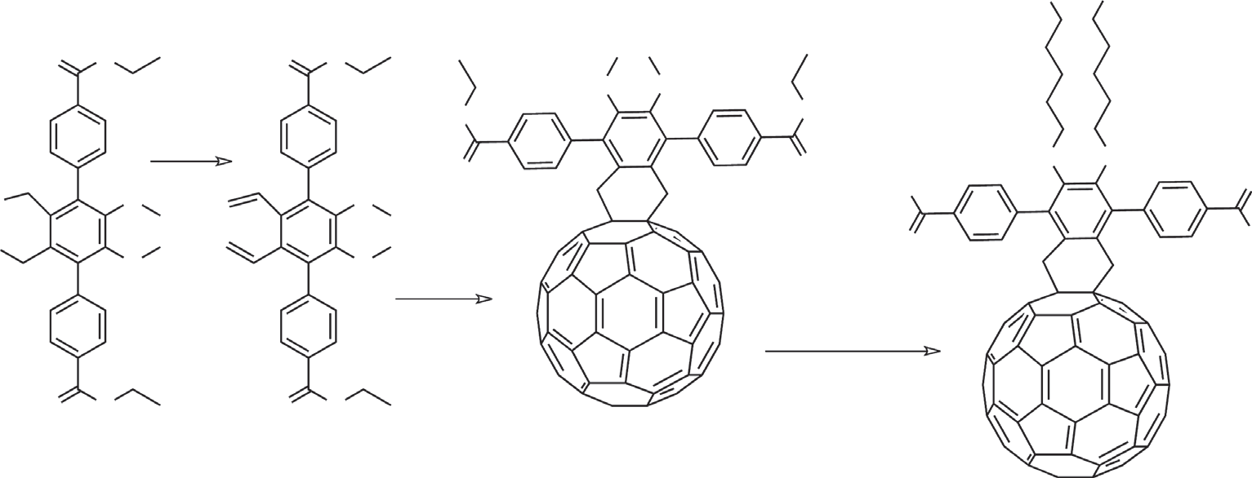
Formation of single adduct (single functional) fullerenes: Each fullerene has 30 p-bonds, many of which are available for supramolecular synthesis, which involves intermolecular interactions. All functionality provided for a chemically modified fullerene in this figure occurs at a single addend attached to the fullerene with covalent bonds. The purpose of the addend is to modify the fullerene with a chemical moiety that provides: (1) an anchor substituent between the fullerene and a metal surface, and (2) a means to interlink with other fullerenes derivatized in the same way or in different ways. The mono adduct contains
thiol groups for bonding to a gold surface and carboxylic acid groups to provide intermolecular bonding (via hydrogen bonds) between fullerenes and the pi−pi interaction capability.
Br
Br

Slide 32
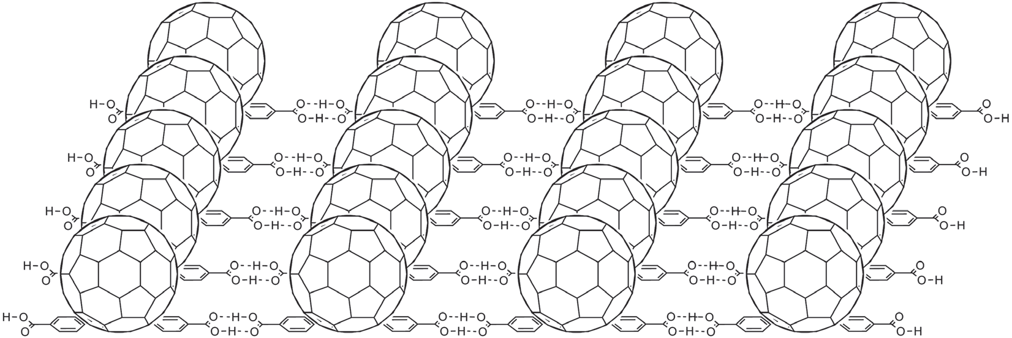
A two-dimensional array of fullerenes (modifi ed as pictured in previous Fig.) on gold substrate is shown. Along the lateral (x) axis, modifi ed fullerenes are held together by hydrogen bonds between carboxylate functionalities. Along the longitudinal (y) axis, fullerenes are attracted to each other via p−p interactions. Molecular models have confirmed the viability of such a system.

Slide 33
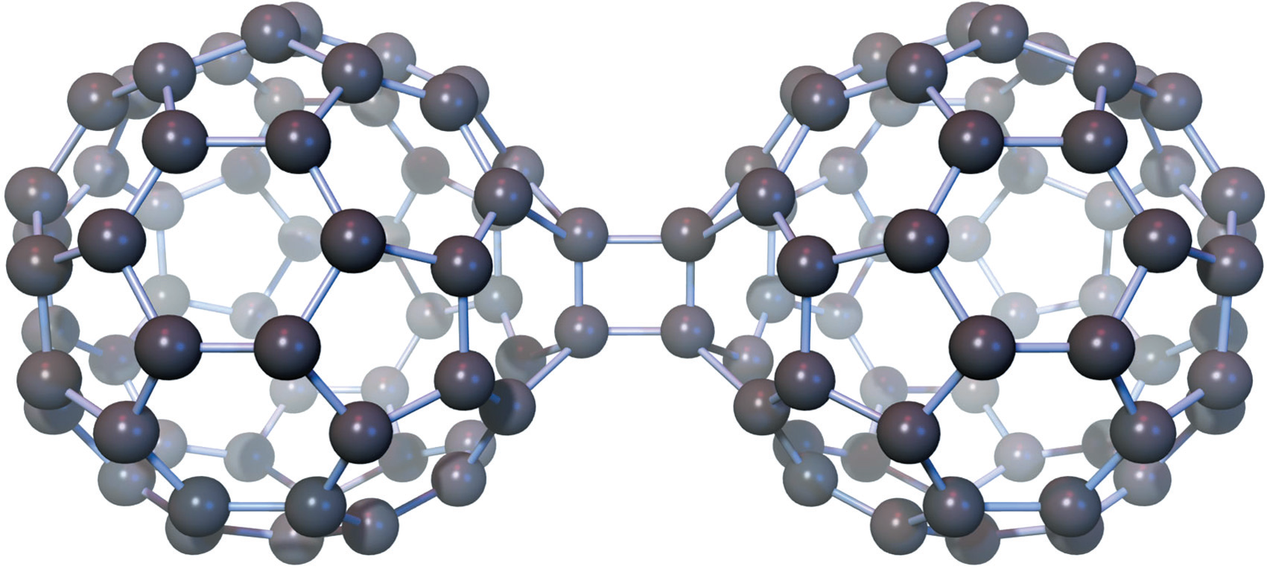
C₆₀ dimer formed by [2 + 2] cycloaddition. The structures are formed during prolonged exposure to UV or laser light. The dimers (and higher forms) are insoluble in solvents that buckyballs normally disperse. The dimers revert to individual C60 molecules by heat treatment under ambient pressure conditions.

Slide 34
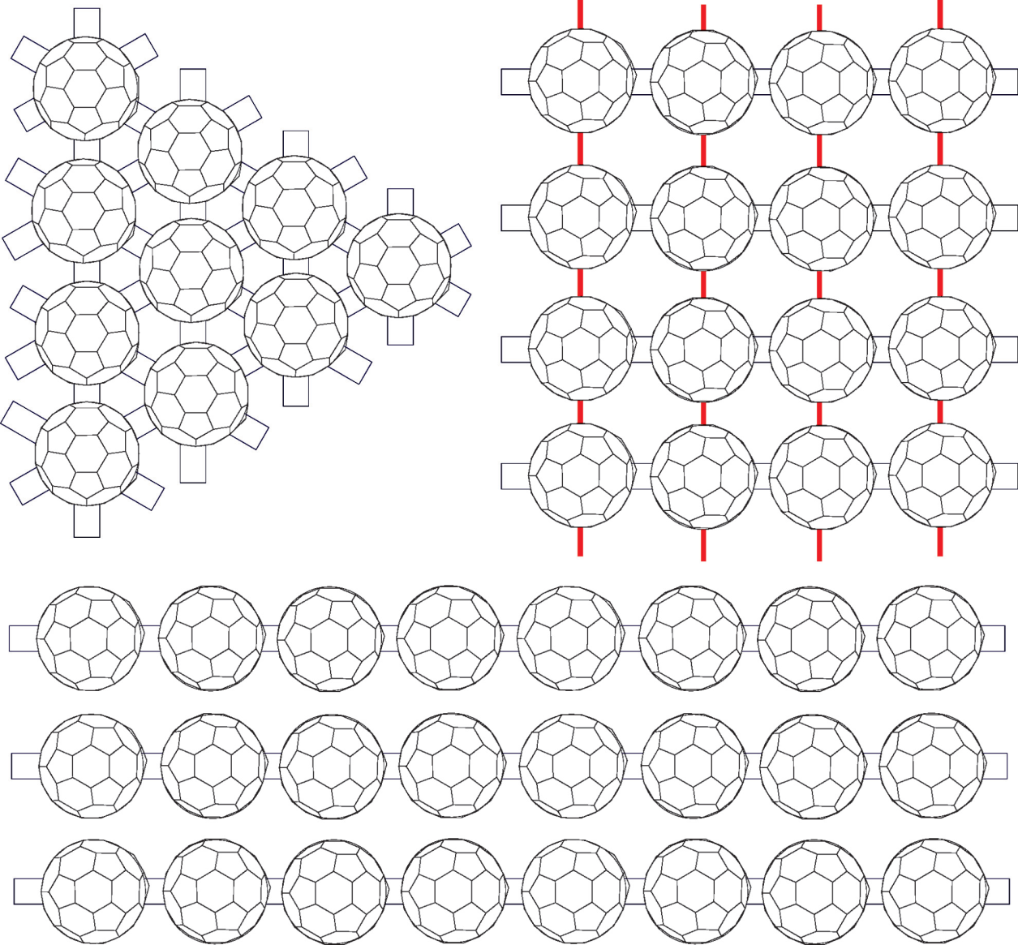
Generic C60 arrays are shown: Top left: rhombohedral; top right; tetrahedral; and bottom: linear orthorhombic polymers. Red lines represent chemical linking groups. Blue squares represent fullerene dimer linkage. Three-dimensional arrays are also possible.

Slide 35
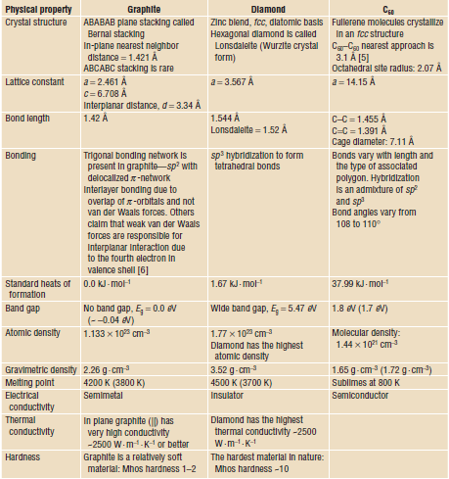

Slide 36
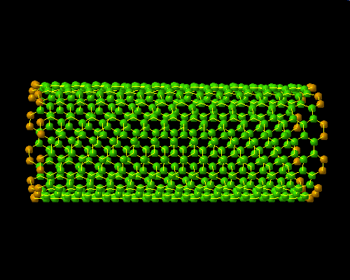
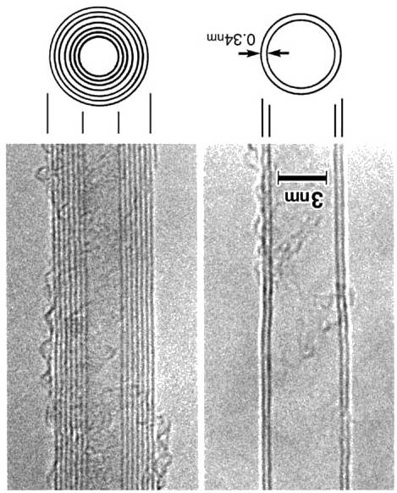
TWO DIFFERENT CLASSES
Multi-wall (MWNTs)
Single-wall (SWNTs)
D_{ext.}= 20÷200 Å
D_{int.} = 10÷100 Å
D = 10÷20 Å
S. Iijima Nature 354: 56 (1991)
S. Iijima, T. Ichihashi Nature, 363: 603 (1993)

Slide 37
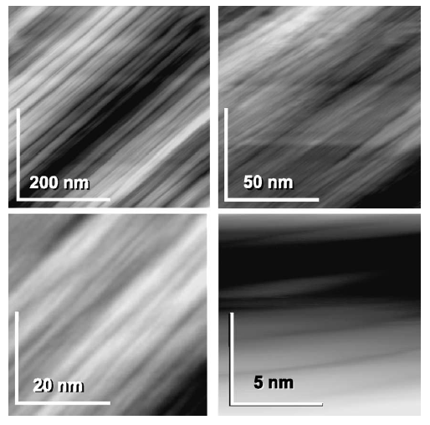
PROPERTIES
ELECTRONIC
MECHANICAL
CHEMICAL
THERMAL
OPTICAL
MAGNETIC
SPINTRONICS

Slide 38
High chemical stability (inertness against oxidation..)
Structural integrity after intercalation and de-intercalation
High performances of gas storage
Feasibility to attach foreign species or chemical groups
Thermal stability (up to 2000 C under vacuum)
Low density (1.33-1.40 g/cm³) (1/6 the weight of steel)
Mechanical Resistance (Young modulus ~1.8 TPa)
Breaking strength : 13-50 GPa (a strain of 6%)
Volume compressibility : 2 x 10 ^{–3} 1/kbar
Reversible deformation modes (bending, axial compression, torsion)
The highest thermal conductivity (2000-6000 W/m·K)
Metallic or semiconducting behaviour
Electrical conductivity (1 GA/cm² )
High efficiency of Field Emission (FE)

Slide 39
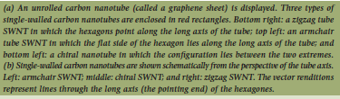
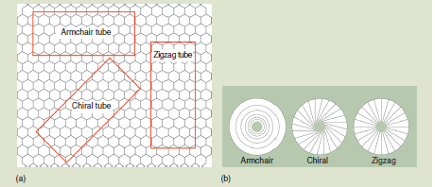
HOW TO ROLL GRAPHENE

Slide 40
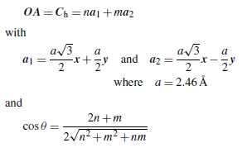
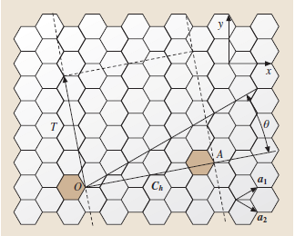
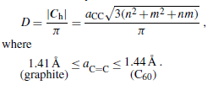
Sketch of the way to make a single-wall carbon nanotube, starting from a graphene sheet
The various ways to roll graphene into tubes are therefore mathematically defined by the vector of helicity C_{h}, and the angle of helicity θ, as follows
a1=a2=2bcos30
bond=a/√3
where n and m are the integers of the vector OA considering the unit vectors a₁ and a₂.
The vector of helicity C_{h}(= OA) is perpendicular to the tube axis, while the angle of helicity θ is taken with respect to the so-called zig-zag axis, i. e., the vector of helicity that makes nanotubes of the “zig-zag” type . The diameter D of the corresponding nanotube is related to C_{h} by the relation:

Slide 41
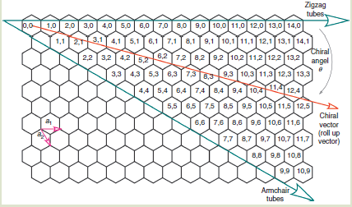
Illustration of nanotube structure and the chiral vector. The dark arrows represent the tube axes of zigzag and armchair tubes. The arrow in the middle represents the tube axis for chiral tubes, the vector sum of the others.
because of the six fold symmetry of the graphene sheet, the angle of helicity θ for the chiral (n,m) nanotubes is such as 0<θ<30◦

Slide 42
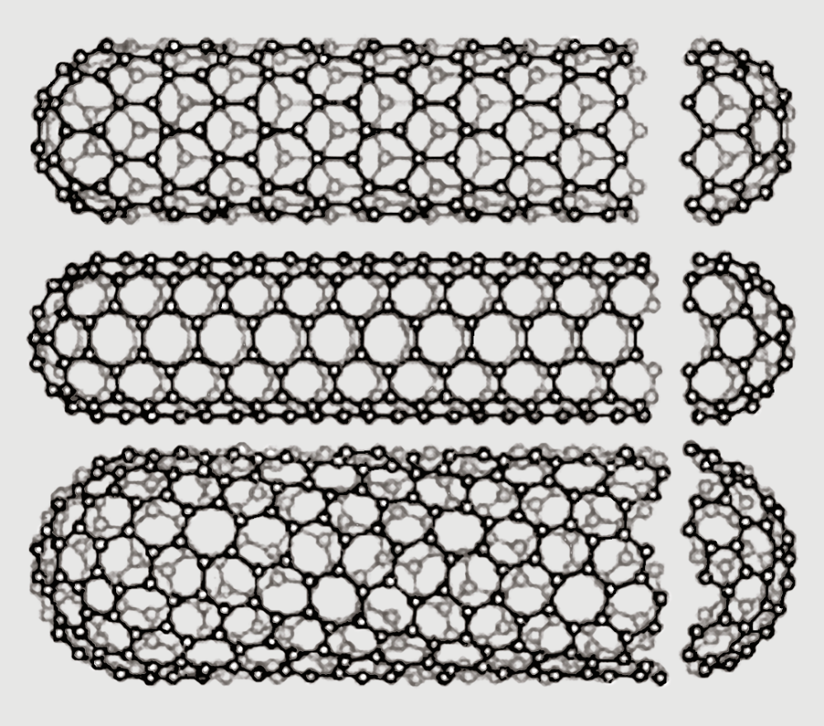
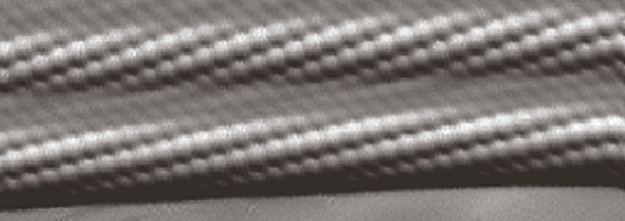
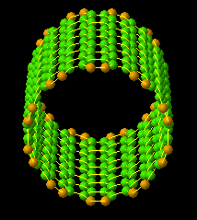
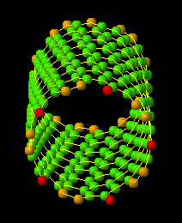
(a)
(b)
(c)
Image of two neighboring chiral SWNTs within a SWNT bundle as seen by high resolution scanning tunneling microscopy
(10,10)
(10,5)
Sketch of three different SWNT structures as
examples for (a) a zig-zag-type nanotube, (b) an armchair type nanotube, (c) a helical nanotube

Slide 43
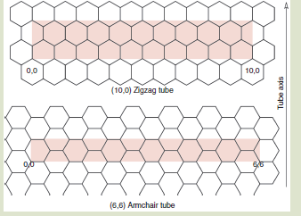
The translational unit cell of a (10,0) zigzag tube is shown below. The width of the cell is equal to √3a, where a is the unit vector for the graphene lattice. The translational unit cell for a (6,6) armchair tube is shown below. The width of this unit cell is equal to the unit vector a of the graphene lattice . Chiral tubes that have lower symmetry are characterized by larger cells than the two depicted in the fi gure. The magnitude of the chiral vector is the circumference of the tube. The magnitude of the translational vector is the width of the cell. The chiral vector (along the circumference) and the translational vector (along the tube axis) are orthogonal to one another.

Slide 44
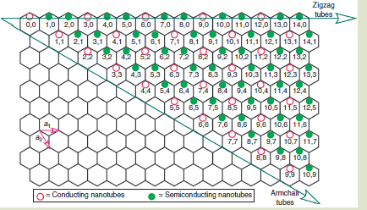
SWNTs are either electrically semiconducting or electrically conducting (metallic). Semiconducting SWNTs are represented by solid green dots and conducting tubes by hollow purple dots. Tubes are conducting if (m – n) or (n – m) is a multiple of 3: n – m = 3q, where q is an integer. Therefore, all armchair tubes are metallic, all zigzag tubes with n a multiple of 3 are conducting, and all chiral tubes that fall into the general category of n – m = 3q are conducting as well.

Slide 45
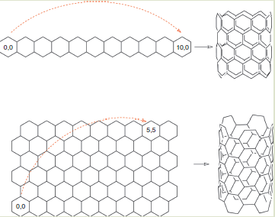
Making (10,0) and a (5,5) carbon nanotubes by folding a graphene transparency.

Slide 46

SWNTs represent the ideal 1D QUANTUM WIRE
The transport properties are dependent on the geometrical characteristics: HELICITY -DIAMETER
Depending on the structure the nanotubes can
have a metal-like or semiconducting behaviour
The electrons are confined along the circumference and propagate exclusively along the axis of the cylinder . The conduction is ballistic.

Slide 47


ELECTRONIC STRUCTURE of SWNT
Confinement of electrons along the tube circumference
k_{c}·C_{h}=2πj
A set of 1D energy states, corresponing to sections of the band structure of 2D graphite .
Depending on the position of allowed wavevector with respect to k-point
METAL-LIKE
SEMICONDUCTOR

Slide 48

Metal-like Nanotubes (zero-gap)
(n,n)
(n,m) | n-m or m-n =3i
All arm chair CNT are conducting as n-m=0 for all arm chair
(6,0), (9,0), (12,0) -> Zigzag tubes are metallic. Others semiconducting
(6,3), (6,9), (6,12)-> Chiral CNT are conducting
The nanotubes (n,n) and (n,m) with n-m=3i behave as 1D metals : the density of states at the Fermi level has a finite value.
In metal-like SWNTs the conduction is due to discrete 1-D electronic states (spaced of about 0.4 meV) which extend along the whole tube length

Slide 49


Semiconducting Nanotubes
(n,m) | n-m≠3i
DOS= 0 at the Fermi level
Dependance of the gap on the diameter
E_{g}~1/R,
0.2 ≤ E_{g} ≤ 1.2 eV
T.W. Odom, J.L. Huang, P. Kim e C.M. Lieber, Nature 391 (1998): 62
The gap decreases with diameter increasing .

Slide 50

Mechanical Properties of Materials
Breaking carbon nanotube is mostly by breaking a bunch of C-C or C=C or combination.
SP2-SP3 covalent bonds are the strength of the carbon nanotube
The specific strength of carbon nanotubes is the order of 48.5 x 10³ kN.m.kg⁻¹
Steel ~ 1.54x10²Gpa

Slide 51
What is the theoretical tensile strength σs in gigapascals (1GPa = 109Nm2) of carbon – carbon bonds of different order? Assume that all bonds stretch to 2.5xtheir respective length before breaking. How much mass under earth’s gravitational pull are these bonds able to hold without breaking?
Type | Bond order | Bond length, L (nm) | Bond dissociation energy (E_{bde}) (kJ.mol⁻¹) | Bond break length, d = 2.5L-L(nm)
C-C | 1.0 | 0.154 | 348 | 0.231
C=(onepi+onecovalent) C | ~1.33 | 0.142 | 480 | +213
C= (two co-valent) | 2.0 | 0.134 | 614 | +0.201
C≡C | 3.0 | 0.120 | 839 | 0.180
Bond dissociation energy=
Force Required =
The covalent radius r_{c} of a carbon atom is 0.077nm-the cross-sectional area A_{c} = πr² = 3.1416x(0.077x10⁻⁹m)²=1.86x10⁻²⁰m²
The tensile strength σ (1Pa=N.m-2) of one C-C bond =
The maximum force F_{max} that one C-C bond is able to hold without breaking is the product of the tensile strength and the area of the material A_{M} (e.g. the diameter of the tube). If only one C-C bond, then F_{max} = A_{m}σ = A_{c}σ=2.50x10⁻⁹N. M_{max}=(F/g)=2.54x10⁻¹⁰kg

Slide 52
Type | Bond dissociation energy (Jx10⁻¹⁹) | Force F (Nx10⁻⁹) | Tensile strength σ(Gpa) | Mass m_{max} (kgx10⁻¹⁰)
C-C | 5.78 | 2.50 | 134 | 2.54
C=(onepi+onecovalent) C | 7.97 | 3.74 | 201 | 3.82
C= (two co-valent) | 10.2 | 5.07 | 272 | 5.18
C≡C | 13.9 | 7.74 | 416 | 7.90
The tensile strength increases with the bond strength. Therefore, theoretical limit of the tensile strength of one of the strongest bonds in nature is quite high. If the mass of two carbons in the bond is 1.99x10⁻²⁶kg, these bonds can hold about 10¹⁵-10¹⁶ times their own mass.

Slide 53
Electrical: One dimentional nanomaterials -> pseudo-one dimentional nanomaterials.
Due to confinement -> electrical conduction is quantized
Resistivity in CNT is constant. So CNT are excellent materials for high current applications. Theoretically 1000 times more than that of silver or copper.
Thermal Properties: Along the tube axis, carbon nanotubes have excellent thermal conductivity to the tune of~6000W.m⁻¹.K⁻¹ at room temperature. Copper->385Wm⁻¹K⁻¹
Along the diameter of the tube, carbon nanotube are insulating
Thermal stability of carbon is very high ~3100K in vacuum

Slide 54

Metallic CNT has no band gap. Semiconducting CNT have a band gap i.e. function of diameter. The band gap ranges from 0.4 to 0.7eV.
E_{g} is the band gap in electron volts. W is the tight binding energy (2.7±0.1eV), and b is the bond length
The difference is best illustration in DOS plots. The DOS is a function of the number of quantum states in the energy range between E and E+dE devided by the product of dE and the volume of the sample. In a metal, the Fermi level is populated and therefore the DOS shows a positive population in that area. For a semiconductor, the Fermi level (technically, the chemical potential) is empty (the band gap), and the DOS in that region has zero population (nostates). As energy is increased on either side, peaks valled van Hove singularities appear. These regions are responsible for the optical properties of carbon nanotubes (e.g., transition between the von Hove singularities).
Optical properties of single-walled carbon nanotubes. Van Hove singularities are shown for (a) (9,9) metallic conducting tubes and (b) (11,7) semiconducting tubes. Note that there is no band gap in the metallic tube (all states populated). The semiconducting tube has the region in the center with no populated states. Optical transitions occur between the van Hove peaks.

Slide 55

Intertube spacing: Armchair: 0.341nm, Zig zag: 0.341nm, Chiral(2n,m):0.339nm

